Slide 1
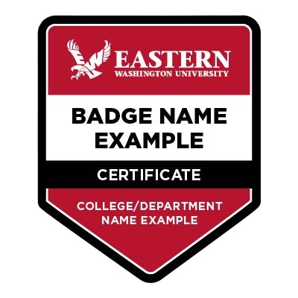
The Future of Skills
EWU PCE Digital Badging Webinar Series
Today’s Agenda:
EWU’s digital badge investment
Current state of EWU digital badging
Future plans for EWU digital badging
Date 03/4/2026 - Employers
Notes:
Links:
EWU PCE Homepage for current and upcoming PCE events - Professional & Continuing Education - EWU - The Region's Polytechnic
EWU Digital Badge Landing page - EWU Digital Badging - Professional & Continuing Education - EWU - The Region's Polytechnic
EWU Parchment Digital Badge Catalog page - Badges - Eastern Washington University Badging
Link to webinar slide deck: https://docs.google.com/presentation/d/1zK2FQg7gHoTZ02cT3F65MQ-JAqSo41By/edit?usp=sharing&ouid=104875589571836536961&rtpof=true&sd=true

Slide 2
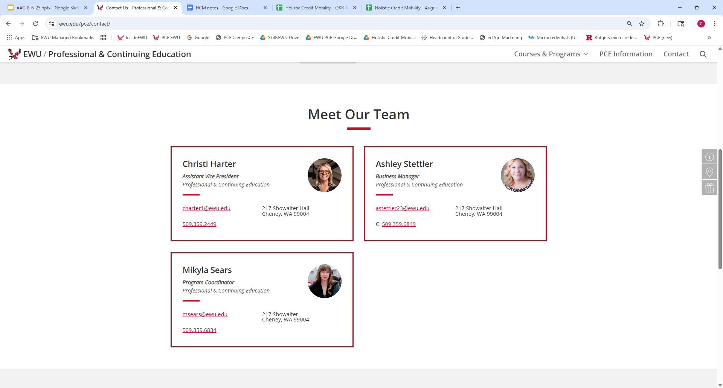

Slide 3

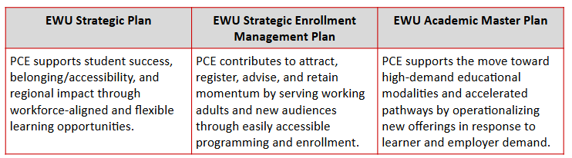
PCE Mission: Offer education programs aligned to workforce demands that empower individuals to enhance their skills, advance their careers, and achieve their personal and professional goals.
Notes:
PCE mission directly aligns to the EWU Strategic Plan, SEM Plan, and Academic Master Plan, as does the use of digital badges to reflect learning and skills attainment related to employability.

Slide 4
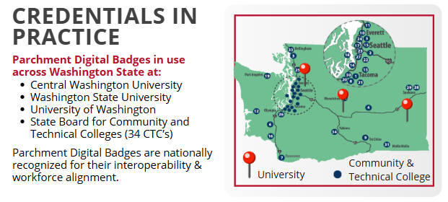
Enhancing Learner Outcomes
with Digital Badges
SKILL RETENTION: Embedded microcredentials improve skill retention and course relevance, according to faculty and student feedback in pilot programs.
BOOSTING STUDENT SUCCESS: 75% of institutions report increased retention through microcredentials.
ALIGNING WORKFORCE NEEDS: 85% of employers prefer candidates with credit bearing microcredentials.
Hanover Research Microcredential Trends May 2025
Notes:
Data on use of microcredentials reflected through digital badges shows skills retention, student success and workforce recognition. EWU is now using this same digital credentialing platform (Parchment Digital Credentials) like many other WA post-secondary institutions.

Slide 5
Questions & Suggestions
Is your organization using (or working towards using) skills-based job descriptions?
If so, what database/skills taxonomy do you use to align skills to job expectations?
Notes:
Christi: Audience questions and suggestions for us to improve the webinars/workshops.

Slide 6
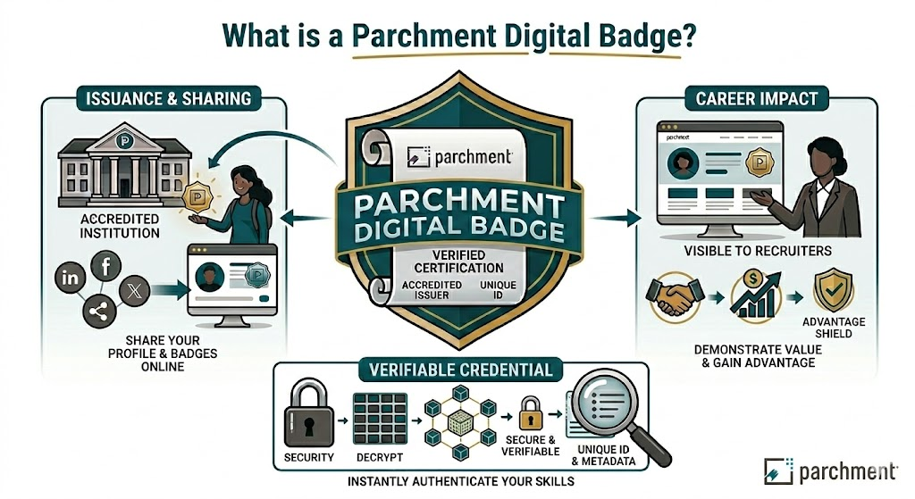
[Image generated by author using Google Gemini AI for Google Workspace, Gemini 3 Flash, 3/2/2026]
Notes:
What Exactly is a Parchment Digital Badge?
Headline: More Than Just a Graphic: A Data-Rich Asset
Talking Points:
Not a static image: Unlike a line item on a PDF resume, an EWU digital badge is an Open Badges 3.0-compliant credential.
Portable & Secure: Badges follow the candidate via LinkedIn, digital portfolios, or direct links, and are secured against tampering.
Granular Insight: Badges represent micro-credentials, specific software proficiencies, capstone project completions, or vital soft skills (like project management or conflict resolution) that a standard degree doesn't explicitly highlight.

Slide 7
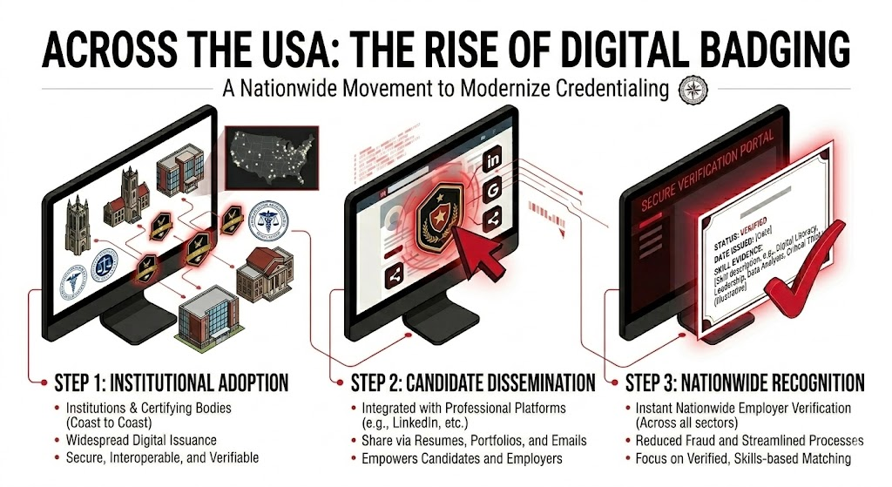
[Image generated by author using Google Gemini AI for Google Workspace, Gemini 3 Flash, 3/2/2026]
Notes:
How to to verify an EWU badge in the wild?
Step 1: Spot the Badge. You will see these pop up on candidate LinkedIn profiles (under "Licenses & Certifications"), embedded in digital resumes, or in email signatures.
Step 2: Click the Link. Clicking the badge routes you directly to the secure Parchment verification portal.
Step 3: Review the Proof. Instantly view the verified status, the date issued, and the evidence of the skill. No logins or fees required for the employer.

Slide 8
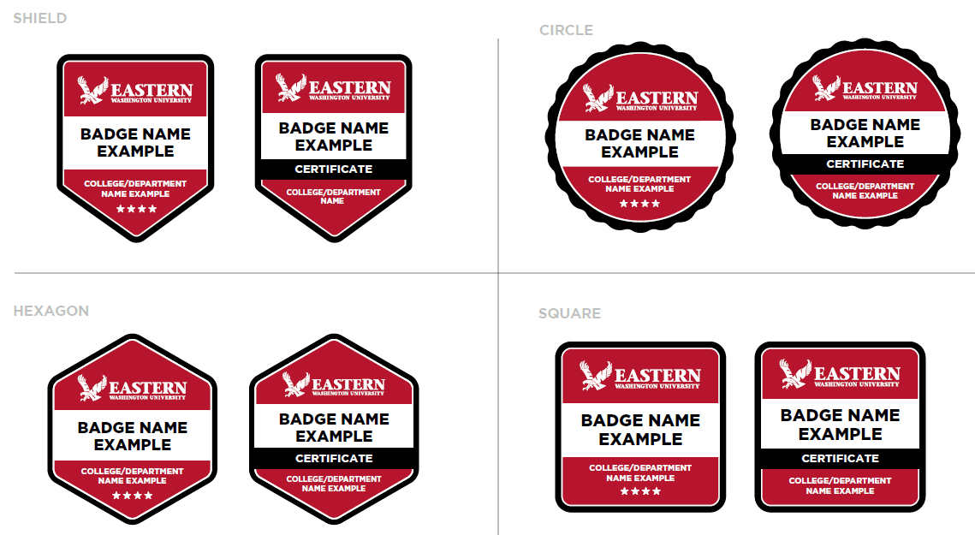
Digital Badge Design:
Skill + Criteria + Evidence + Verification
Notes:
Mikyla: At EWU, these badges (as shown on the screen) are secure, verifiable digital credentials that turn students academic achievements into a professional identity. These badges are intentionally designed to align to a digital badge taxonomy (developed through standards and governance structures at EWU), covering areas of Academic Learning, Professional Development, Student life and Standalone Categories which is an area designed to support collaborative work with employers outside of the other three groups. Each badge contains metadata that highlights specific skills and evidence of learning to create a clickable portfolio that gives students a competitive edge. Digital credentials are easily shared on LinkedIn, social media, through a QR code, or added to a resume. A digital badge is not a replacement for a degree or traditional transcript. It is not a participation trophy. It is a verifiable enhancement of the learners transcript, earned through demonstrated proficiency or skill attainment. While digital badges can increase marketing and brand awareness, they represent more than our EWU logo. Every badge upholds institutional standards and requires multi-level approval and validation to ensure quality and accuracy.

Slide 9
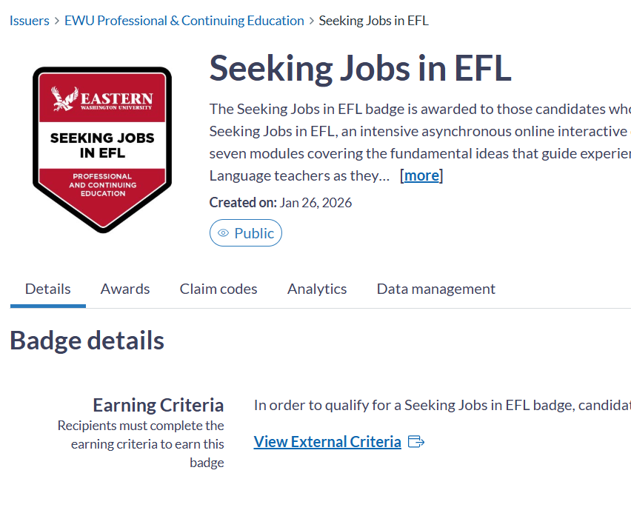
TEFL Example
Supported Details in MetaData
Badge name
Badge Description
Credit or Hours Associated
Earning Criteria
Skills Aligned to Learning Outcomes
Verified, evidence-based, tamper-proof, portable digital credential - shared by recipient
Optional: supplemental artifacts (e.g., assessments, reflections, demonstrations)
EWU Parchment Digital Badges Dashboard
Notes:
Mikyla: In this example, you can see what the badge looks like for the user. If you think of a digital badge as a container, the metadata is the nutrition label. While the image is what makes it recognizable, the metadata is the verifiable data inside that proves exactly what you learned and why it’s valuable to an employer. The metadata acts like a digital seal, proving the badge is authentic and the data is tamper evident - making it impossible for a student or third party to alter the details.
When you click an EWU digital badge, you aren't just seeing a certificate. You get access to the "metadata"—the actual DNA of the achievement.
Issuer: Verified as Eastern Washington University.
Earning Criteria: Exactly what the student had to do to earn this (e.g., "Completed a 40-hour practicum in Python data analysis").
Evidence: Deep links to the candidate’s actual coursework, portfolios, or capstone projects. You can literally see the work before you interview them.

Slide 10
Questions & Suggestions
Does your HR department accept digital credentials like Parchment digital badges?
What verified information would you want provided on a digital badge/credential?
What types of certificates does your organization accept on an applicant’s profile?
Notes:
We understand that a student’s minor in their degree is not able to be represented on a job application.

Slide 11
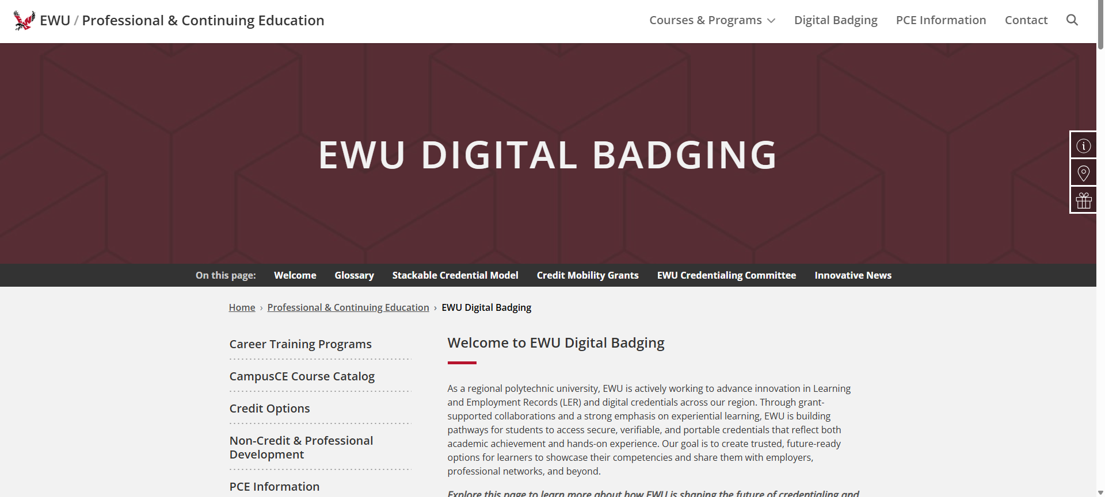
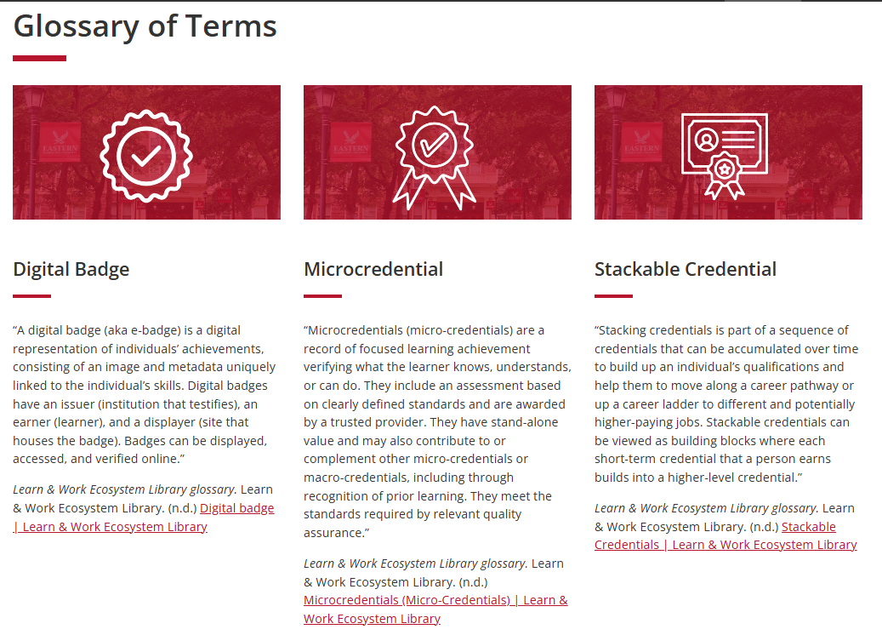
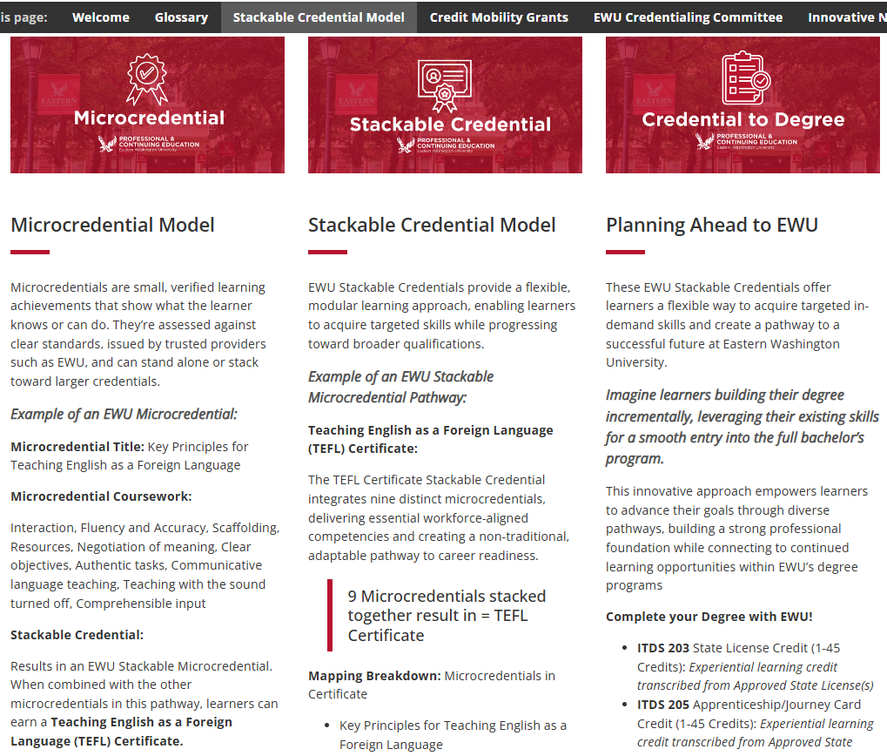
PCE Pilot (2025-26) to EWU Pilot (2026-27)
Learn about EWU Digital Badging and stay connected!
Notes:
Mikyla: EWU has expanded its investment in this work; EWU PCE secured grant funding to cover learner fees for two year‑long pilots: covering 2025-2027 academic timeframe . This support comes from grant funding tied to learning & employment records and advancing holistic credit mobility. We invite you to learn more about this pilot and our EWU Badge efforts through the EWU Digital Badging website, a dedicated webpage that covers a glossary of terms for shared language understanding, examples of what EWU will be able to provide our students through badging, a direct link to the EWU Parchment Badge Catalog website and correlated grants that EWU is connected to across the nation.
Link: EWU Digital Badging - Professional & Continuing Education - EWU - The Region's Polytechnic
In support of this work, EWU also issues microcredentials, such as the TEFL example from earlier and shown on our webpage - targeted, validated learning achievements that clearly demonstrate what an individual knows or can do, and which can be combined to build toward a full certificate. These microcredentials are assessed against defined standards and issued by trusted providers, such as EWU, giving employers like you a portable, interoperable way to recognize real skills. These microcredentials, along with digital badges and certificates, demonstrate how EWU’s digital credentials helps employers quickly identify candidates with specific, job‑ready capabilities.

Slide 12
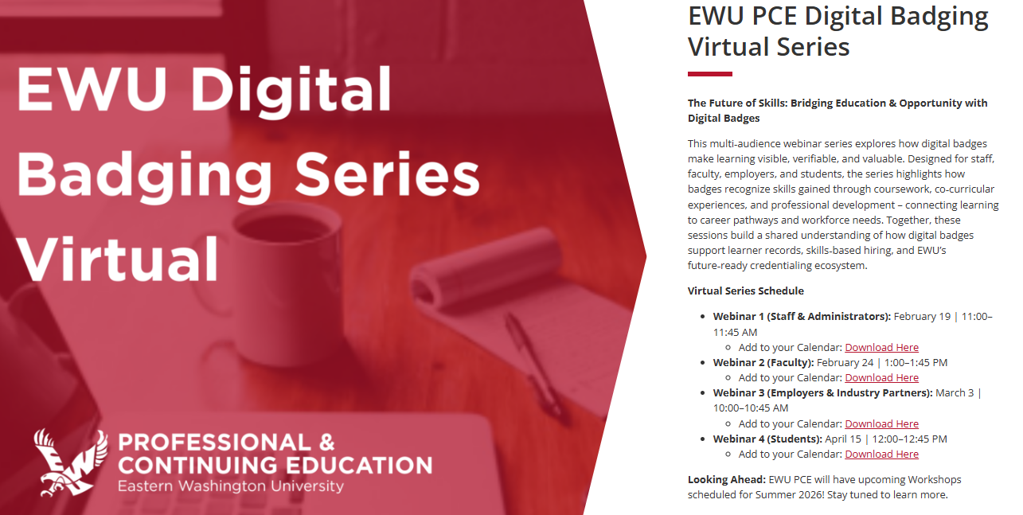
https://www.ewu.edu/pce/digital-badging/
Notes:
Mikyla: Fall 2026: Launch of EWU Workshop Series for the various audiences (Staff & Administrators; Faculty; Employers; and Students)
At Eastern Washington University, we’re expanding our digital badging and credentialing efforts to help employers identify real, verifiable skills in the talent pipeline. Our digital badges and microcredentials are built to make learning visible, validated, and aligned to workforce needs, to support skills‑based hiring across industries. EWU PCE will be offering additional digital badge workshops beginning this upcoming Fall 2026, which gives employers opportunities for hands‑on learning on how these digital credentials support recruitment, upskilling, and partnership pathways. We welcome you to join us, explore our badge catalog, and partner with EWU as we build a future‑ready credentialing ecosystem together.

Slide 13
Questions & Suggestions
Connect with our Team Today
Email: PCE@EWU.EDU
Office: 217 Showalter Hall, Cheney
Website: ewu.edu/pce
Thank You!
Notes:
Wrap Up and Close

