Slide 1
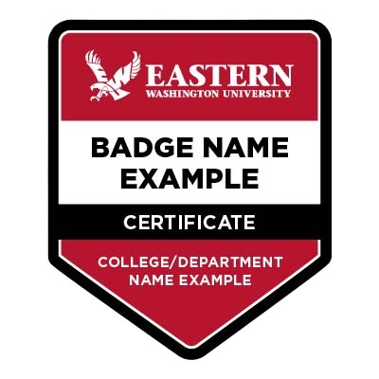
The Future of Skills
EWU PCE Digital Badging Webinar Series
Today’s Agenda:
EWU’s digital badge investment
Current state of EWU digital badging
Future plans for EWU digital badging
Date 04/15/2026 - Students
Notes:
Links:
EWU PCE Homepage for current and upcoming PCE events - Professional & Continuing Education - EWU - The Region's Polytechnic
EWU Digital Badge Landing page - EWU Digital Badging - Professional & Continuing Education - EWU - The Region's Polytechnic
EWU Parchment Digital Badge Catalog page - Badges - Eastern Washington University Badging
Link to webinar slide deck: https://docs.google.com/presentation/d/1zK2FQg7gHoTZ02cT3F65MQ-JAqSo41By/edit?usp=sharing&ouid=104875589571836536961&rtpof=true&sd=true

Slide 2
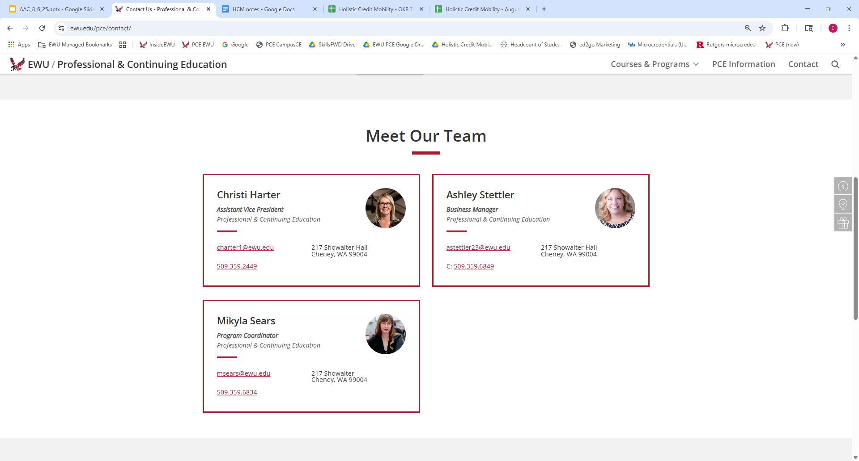

Slide 3

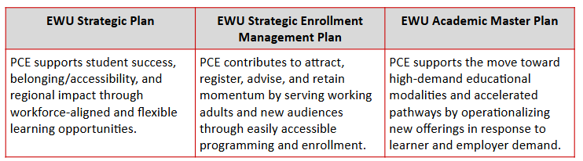
PCE Mission: Offer education programs aligned to workforce demands that empower individuals to enhance their skills, advance their careers, and achieve their personal and professional goals.
Notes:
PCE mission directly aligns to the EWU Strategic Plan, SEM Plan, and Academic Master Plan, as does the use of digital badges to reflect learning and skills attainment related to employability.

Slide 4
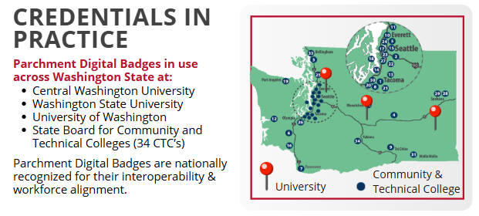
Enhancing Learner Outcomes
with Digital Badges
SKILL RETENTION: Embedded microcredentials improve skill retention and course relevance, according to faculty and student feedback in pilot programs.
BOOSTING STUDENT SUCCESS: 75% of institutions report increased retention through microcredentials.
ALIGNING WORKFORCE NEEDS: 85% of employers prefer candidates with credit bearing microcredentials.
Hanover Research Microcredential Trends May 2025
Notes:
Data on use of microcredentials reflected through digital badges shows skills retention, student success and workforce recognition. EWU is now using this same digital credentialing platform (Parchment Digital Credentials) like many other WA post-secondary institutions.

Slide 5
Questions & Suggestions
Where have you seen digital badges in use?
Notes:
Christi: Audience questions and suggestions for us to improve the webinars/workshops.

Slide 6
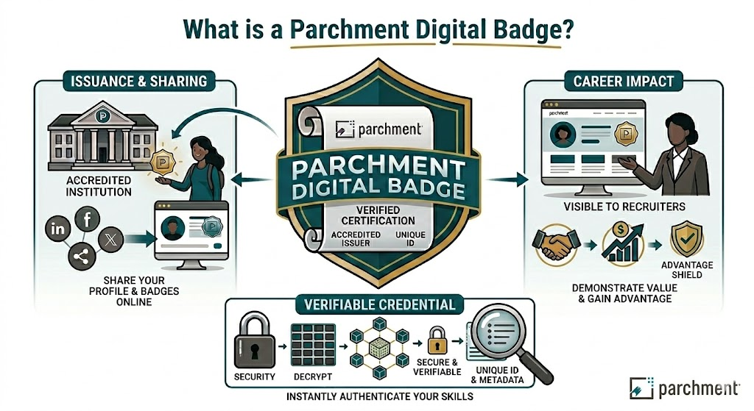
[Image generated by author using Google Gemini AI for Google Workspace, Gemini 3 Flash, 3/2/2026]
Notes:
Mikyla: You might be wondering, 'What exactly is a Parchment digital badge?' Think of it as a verified, high-tech version of a traditional certificate. It’s an instantly authenticatable record of your skills. When an accredited institution, like EWU, issues you a badge, it includes a unique ID and metadata that makes it tamper-proof. You can share these badges across your professional social media, like LinkedIn, or even in your email signature to give you an advantage with recruiters who are looking for verified proof of your abilities right up front. (next slide please)

Slide 7
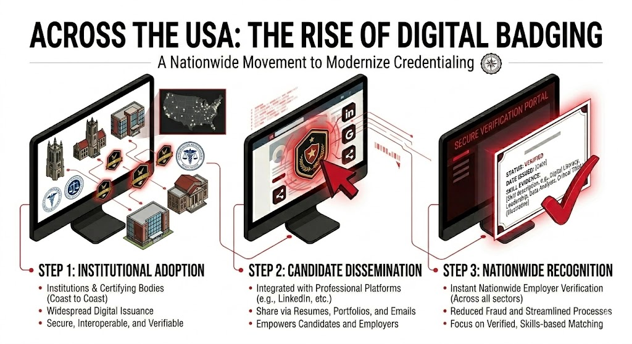
[Image generated by author using Google Gemini AI for Google Workspace, Gemini 3 Flash, 3/2/2026]
Notes:
Mikyla: EWU is part of a large nationwide movement to modernize how you show off your credentials. This isn't just a local trend; it's being adopted by certifying bodies from across Washington State and nationally, coast to coast. The process is simple:
Step 1: EWU issues you a secure, verifiable badge.
Step 2: You integrate that badge into your professional platforms and resumes.
Step 3: Employers across all sectors can instantly verify your skills through asecure portal, reducing fraud and ensuring you get matched with jobs thatactually fit your skill set.
(next slide please)

Slide 8
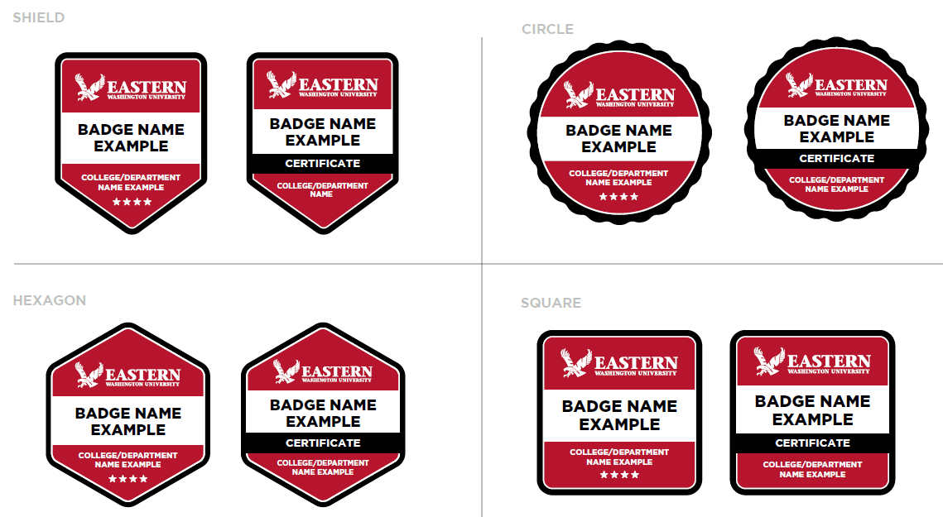
Digital Badge Design:
Skill + Criteria + Evidence + Verification
Notes:
Mikyla: Every EWU badge is designed with four key components: the Skill you learned, the Criteria you met, the Evidence of your work, and the Verification that it’s official. Each badge shape denotes a specific area; Sheild (acadmic achievements), Circle (student life such as extra and/or co-curriculars), Hexagon (professional development) and Square (curated or unique offerings outside the other categories). You can earn an individual badge for successful completion of a specific skill or a single course( these are the badges to the left in each category). However, if you are looking to build a more comprehensive portfolio, you can choose a Stackable Credential Pathway offering. These stackable credential pathways are designed as a specific sequence of microcredentials together that culminate in a Certificate Badge. You can easily identify these because they feature a distinctive black band across the middle with the word 'CERTIFICATE'. (these are the badges to the right in each category). For example, in our TEFL program, completing nine distinct microcredentials results in that official Certificate Badge, signaling to employers that you’ve completed a full suite of professional competencies. When someone clicks on your badge, they see a deep dive into your achievement, including the badge name and description, the credits or hours you earned, and the specific skills you attained. We can even include supplemental artifacts like your actual assessments or reflections so employers can see your work in action. A digital badge is not a replacement for a degree or traditional transcript. It is not a participation trophy. It is a verifiable enhancement of the learners transcript, earned through demonstrated proficiency or skill attainment. (next slide please)

Slide 9
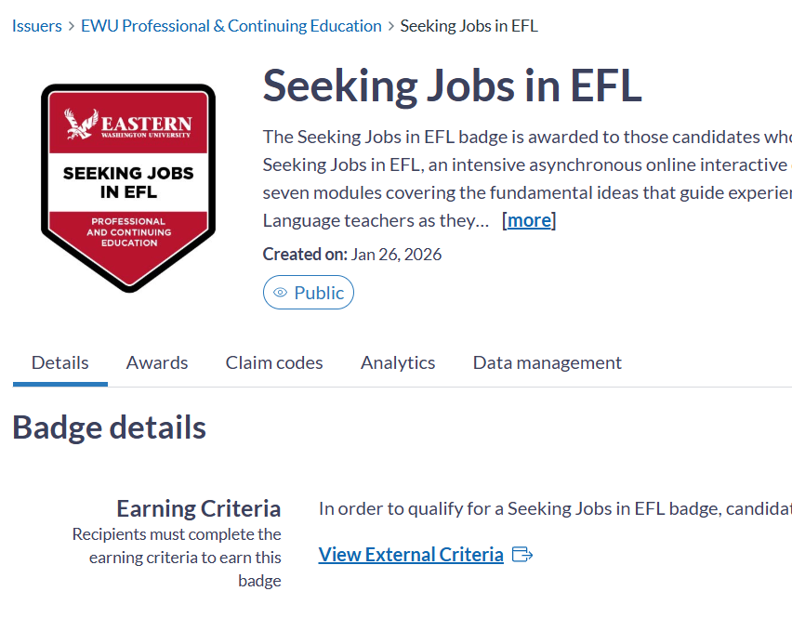
TEFL Example
Supported Details in MetaData
Badge name
Badge Description
Credit or Hours Associated
Earning Criteria
Skills Aligned to Learning Outcomes
Verified, evidence-based, tamper-proof, portable digital credential - shared by recipient
Optional: supplemental artifacts (e.g., assessments, reflections, demonstrations)
EWU Parchment Digital Badges Dashboard
Notes:
Mikyla: To give you a real-world look, here is one of our active badges, Teaching English as a Foreign Language (TEFL). You can see the 'Earning Criteria' section clearly explains exactly what a student had to do to earn this credential. If you think of a digital badge as a container, the metadata is the nutrition label on that container. While the image is what makes it recognizable, the metadata is the verifiable data inside that proves exactly what you learned and why it’s valuable to an employer. The metadata acts like a digital seal, proving the badge is authentic and the data is tamper evident - making it impossible for someone to alter the details after it's been issued.
●When you click an EWU digital badge, you aren't just seeing a badge or certificate. You get access to the "metadata"—the actual DNA of the achievement. You can see key areas, such as that the Issuer is Verified as Eastern Washington University, the Earning Criteria explains exactly what the student had to do to earn this (e.g., "Completed a 40-hour practicum in Python data analysis") and the Evidence offers a deeper exploration to the badge earners actual coursework, portfolios, or capstone projects. Employers can literally see the work before you have an interview with them.
(next slide please)

Slide 10
Questions & Suggestions
What verified information would you want provided on a digital badge/credential?
Where would you populate your digital badge/credential (i.e. LinkedIn, email signature, employer communications)?
Notes:
Mikyla:. Now, we want to hear from you. Thinking about your own career goals:
What verified information would you want provided on your digital badge to impress an employer?
And where are you most likely to share it? Would it be LinkedIn, your email signature, or directly in communications with a hiring manager?
Note: We understand that a student’s minor in their degree is not able to be represented on a job application

Slide 11
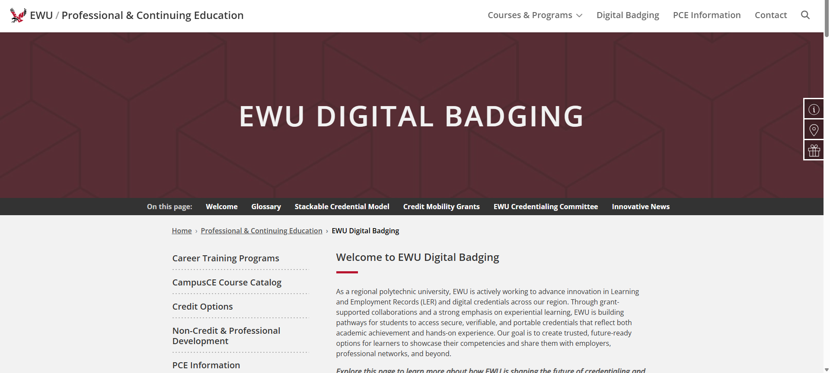
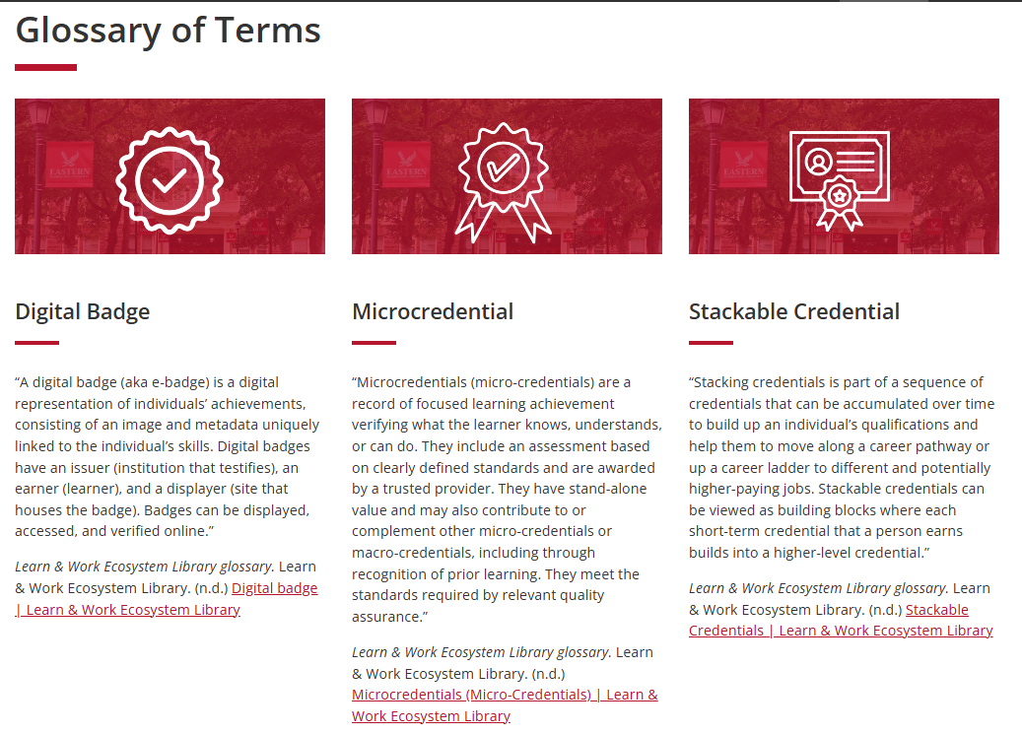
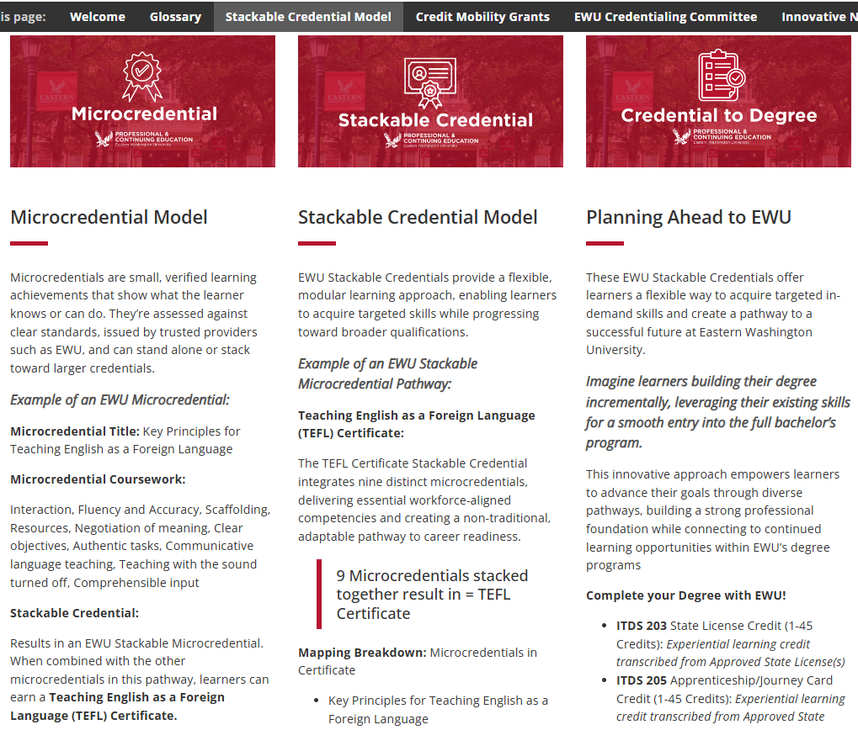
PCE Pilot (2025-26) to EWU Pilot (2026-27)
Learn about EWU Digital Badging and stay connected!
Notes:
EWU has expanded its investment in this work; EWU PCE secured grant funding to cover learner fees for two year‑long pilots: covering 2025-2027 academic timeframe . This support comes from grant funding tied to learning & employment records and advancing holistic credit mobility. We invite you to learn more about this pilot and our EWU Badge efforts through the EWU Digital Badging website, a dedicated webpage that covers a glossary of terms for shared language understanding, examples of what EWU will be able to provide our students through badging, a direct link to the EWU Parchment Badge Catalog website and correlated grants that EWU is connected to across the nation.
Link: EWU Digital Badging - Professional & Continuing Education - EWU - The Region's Polytechnic
In support of this work, EWU also issues microcredentials, such as the TEFL example from earlier and shown on our webpage - targeted, validated learning achievements that clearly demonstrate what an individual knows or can do, and which can be combined to build toward a full certificate. These microcredentials are assessed against defined standards and issued by trusted providers, such as EWU, giving employers like you a portable, interoperable way to recognize real skills. These microcredentials, along with digital badges and certificates, demonstrate how EWU’s digital credentials helps employers quickly identify candidates with specific, job‑ready capabilities.

Slide 12
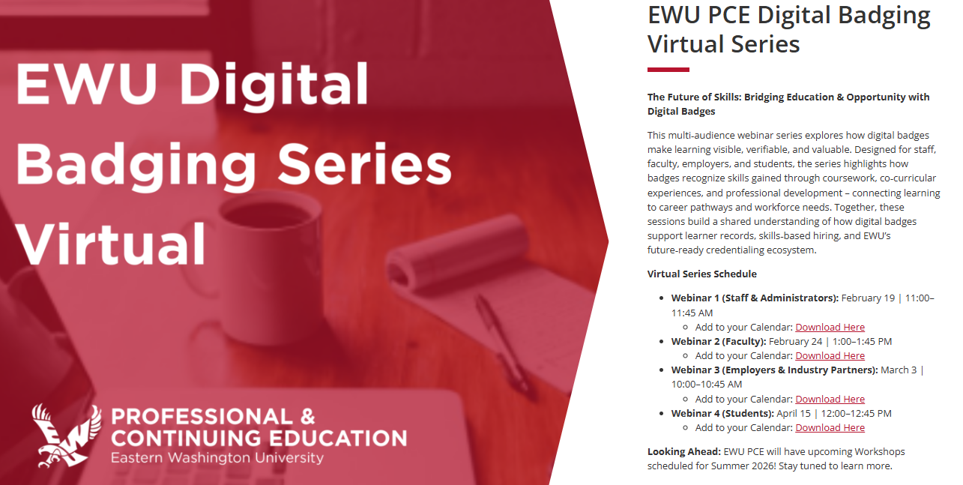
https://www.ewu.edu/pce/digital-badging/
Notes:
Fall 2026: Launch of EWU Workshop Series for the various audiences (Staff & Administrators; Faculty; Employers; and Students)
At Eastern Washington University, we’re expanding our digital badging and credentialing efforts to help employers identify real, verifiable skills in the talent pipeline. Our digital badges and microcredentials are built to make learning visible, validated, and aligned to workforce needs, to support skills‑based hiring across industries. EWU PCE will be offering additional digital badge workshops beginning this upcoming Fall 2026. We welcome you to join us and explore our badge catalog as we build a future‑ready credentialing ecosystem.

Slide 13
Questions & Suggestions
Connect with our Team Today
Email: PCE@EWU.EDU
Office: 217 Showalter Hall, Cheney
Website: ewu.edu/pce
Thank You!
Notes:
Wrap Up and Close

